Slide 1
Bellwork 10/15
We will not have written bellwork this week; however, you need to be prepared to discuss what we’re working on. This week is a short week, Friday is a teacher work day.
Please be prepared to answer: What is the new unit we’re moving on to this week?
Please make sure you have your notebook and your history book.
Last call for test correction sheets! If they aren’t in the inbox by the end of the day, they will not be accepted.

Slide 2
Bellwork 10/16
Remember we have no written bellwork this week.
Please be prepared to discuss some of the things we read yesterday.
Make sure you have a textbook and your notebook.

Slide 3
Unit 2: Canada and the United States
Region: North america

Slide 4
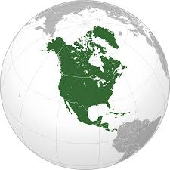
Unit 2: Chapter 3-8
All about Canada and the U.S.
Not all of North America: Region
Latin or Central America in N. America
  Geographically: included
  Culturally separate
Introducing the region: pages 42-49
  Physical Geography
  Human Geography

Slide 5
Introducing the Region: Physical Geography
North America = Canada+United States+ Latin America
Boundaries:
  North: Arctic Ocean East: Atlantic Ocean
  South: Gulf of Mexico West: Pacific Ocean
Two Subregions: Canada/Alaska, 48 continental United States
  Separated by 49th parallel and St. Lawrence River

Slide 6
Physical Features: Canada and Alaska
Shield: Core of old rock at center of continent
Plains: Flat or gently rolling land
Canadian Shield covers almost ½ of Canada
  Rest of landscape is island, lakes, plains, mountains
Great Lakes: World’s largest group of freshwater lakes
Highest Mountain in North America, Mt. Denali (McKinley in the book) elevation 20, 320 ft.
(Mt. Everest is 29, 029 ft.

Slide 7
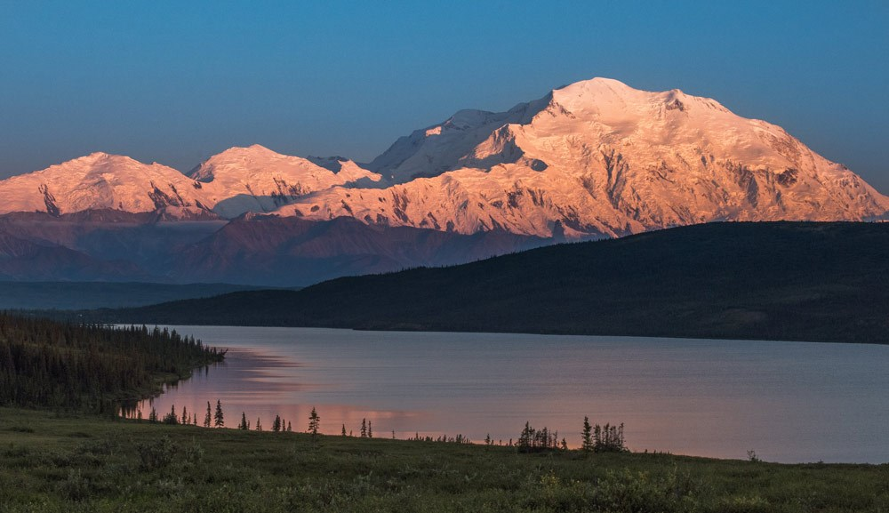
Mt. Denali (Mt. McKinley)
Named in 1917 after President McKinley
Original Athabaskan name was Denali,
“The Great One”
People have been fighting to have it
officially changed for years.
Ohio blocked the change:
McKinley’s birthplace
President Obama used Ex. Order
With Secretary of Interior in 2015

Slide 8
Physical Features: Continental U.S.
Two major mountain ranges: Rockies and Appalachians
  Appalachians: East
  Rockies: from Alaska to New Mexico
Between mt. ranges: “ Great Plains” for about 2,500 miles
  Dry and treeless (remember talking about Dust Bowl?)
Rivers drain down to Mississippi, then to Gulf

Slide 9
Climate and Vegetation: Canada/Alaska
North: tundra and subarctic: long winters and cool, short summers
  Treeless, low grasses, moss, scrub
South: warmer summers (still COLD winters)
  Southeastern: Mixed forest, trees!
  Great Plains: grass, good farmland; no trees (not enough rain)
West Coast: Marine climate, more rain than snow
Most of Canada and Alaska: Coniferous forest

Slide 10
Bellwork 10/17
Please be prepared to discuss what we read yesterday.
Make sure you have a textbook (pg 45) and your history notebook.

Slide 11
Climate and Vegetation: Continental U.S.
No tundra or subarctic: CONTINENTAL (Not Alaska)
MANY different climate zones: tropical, marine, highland, arid, etc
Same for vegetation: Mixed forest, grasses, swamps, desert scrub, chapparal
Climate Map: page 560 Veg map: page 562

Slide 12
Human Geography
Canada is second largest country in world, but U.S. has 9x the pop.
Both colonized by Europeans 500 years ago
Similar cultural background
Both speak English (Canada also uses French)

Slide 13
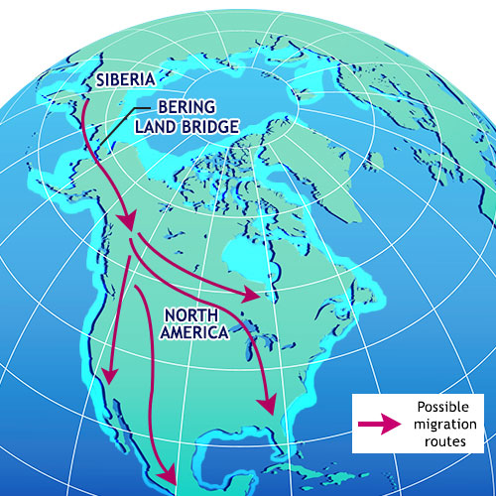
History
First people: Traveled from Asia to
Alaska (Bering Land Bridge, boats) over 10,000
years ago
Settled entire continent, continued moving south

Slide 14
Colonial Period
United States was colonized by Europeans
  French and British along East Coast
  Spanish: Florida, Texas, California
American Independence: 1783
Canada colonized mostly by French
  British won Canada from French in 1763
Canadian Independence: 1931

Slide 15
Modern Era
Canada and U.S. are close allies
Fought together with Europe to help end WWII
A LOT of trade between the two countries; many Canadian-made or United States-made products cross the border
NAFTA in 1994: North American Free Trade Agreement
  Some people think it created more jobs and opportunity, some argue it contributes to the loss of jobs in U.S.; wage differences, cheaper to move factories, etc
  President Trump is in the process of changing it, to be known as U.S.-Mexico-Canada Agreement, USMCA

Slide 16
10/18
Please be prepared to discuss what we read yesterday
You need your history book and your notebook

Slide 17
Population
More than 337 million people between both Canada and U.S.
Not distributed evenly; 80% Urban because of environment (too cold, etc)
Majority = Christian, but there are many other religions represented, including Judaism, Buddhism, Islam and Indigenous religions.

Slide 18
Economic Activity
Both Canada and United States have lots of natural resources
  Commercial Farming: plants and livestock
  Forestry
  Oil/Coal
  Metals like gold, nickel, copper, uranium
Trade
Manufacturing

Slide 19
Bellwork 10/22
Start a new bellwork for the week.
Why did we use an iceberg to discuss culture last week?
Make sure you have the culture sheet from Friday.
Housekeeping: I will be gone tomorrow for a training, fyi.

Slide 20
Bellwork 10/23
How did you do on the mental map from yesterday?
Was there anything about this that surprised you? (things you could/could not remember, locations, how it looked, etc?)
When you are finished, please get out your mapping lab and a textbook.
Challenge 1 and 2 should be done by the end of class.
If you finish early, you could move on to Challenge 3 or read a library book, or work on other homework.

Slide 21
Bellwork 10/24
How did it go with the sub yesterday?
How far did you get on the mapping lab yesterday?
Please get out the mapping lab and a textbook.
Reminder: Due date is Friday!
Any questions for completing Challenge 3?

Slide 22
Bellwork 10/25
What information that you have learned about Canada and the United States has surprised you the most?
Please get out the mapping lab and a textbook.
FYI: we need to add in a page to our mapping lab (we are not taking any OUT). Please take out the staples.
Goal for today: Finish Challenge 3 and Challenge 4. If you don’t get this far, you need to take it home for homework!

Slide 23
Bellwork 10/26
What patterns do you notice about where people live, and why? (EQ for this section)
Please give me some (respectful, constructive) feedback about the mapping lab. It is required, but I could change how we do it another year. Try for one positive thing and one thing you might change.
Please get out your mapping lab and your textbook.
Remember this is due today! Unless I have already talked to you, it needs to be turned in by the end of class.

Slide 24
Locations
Google Earth

Slide 25
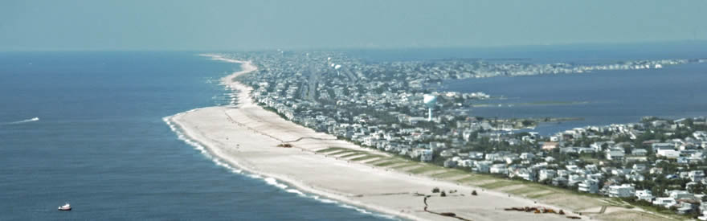
Location A
New Jersey

Slide 26
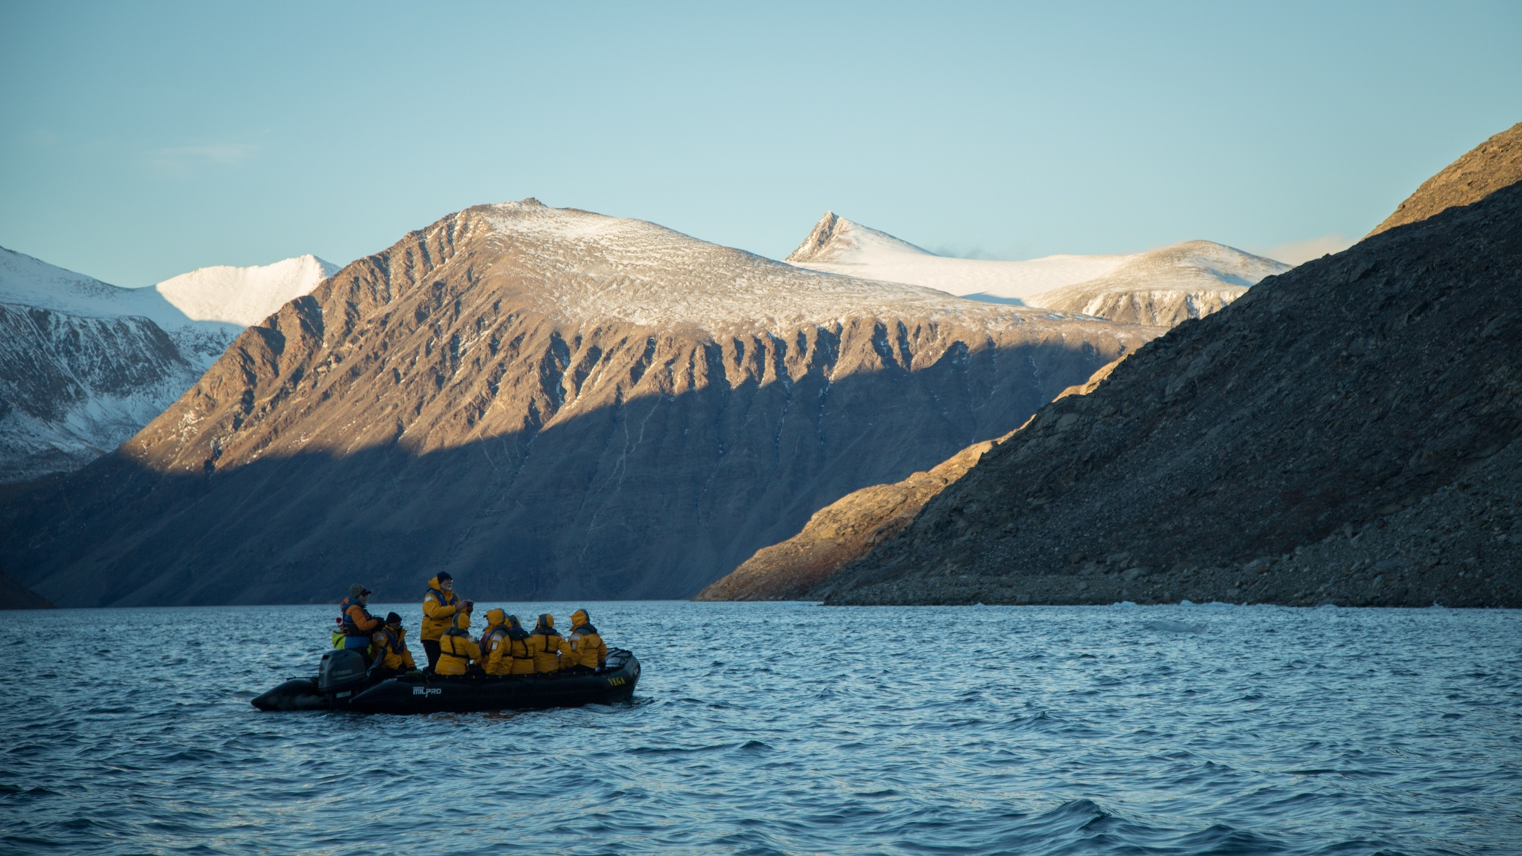
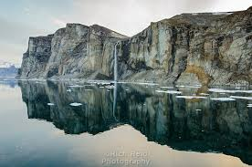
Location B: Baffin Island, Canada

Slide 27
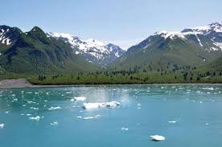
Location C: Alaskan Gulf

Slide 28
Chapter 3: Next slide

Slide 29
Chapter 3: Settlement Patterns and Ways of Life in Canada
People live very differently in different regions of Canada
Plural Society: Many Canadians come from different countries and cultures
Five Regions
  Atlantic
  Core
  Prairie
  Pacific
  Northern

Slide 30
Three “Founding Peoples”
1) Native Americans: Traveled over land bridge
2) French, early 1600s
3) English, 1800s. Followed by immigrants from all over
  Lots of traditions, languages, cultures
Large Area, Small population
Ecumene: area well suited for permanent settlement by people
Much of Canada is beyond the ecumene: most of Canada’s population lives close to U.S. border

Slide 31
Five Regions of Canada
Regions are then divided into smaller land: Provinces
Atlantic: Atlantic coast. Consists of Newfoundland, New Brunswick, Prince Edward Island, Nova Scotia
Core: Eastern Canada, North of Great Lakes. Ontario and Quebec
Prairie: Central plains. Includes Manitoba, Saskatchewan, Alberta
Pacific: Pacific Coast. Province of British Columbia
Northern: To the north of the rest of the provinces, into Arctic Ocean. Yukon, Northwest, Nunavut:
  “Our Land”: homeland for Inuit people

Slide 32
Pages 56-61
These pages discuss each region, and cover the topics of:
  Settlement patterns: Who lives where?
  Who speaks what?
  Having Fun in the Cold: Climate
  Traditions and Needs
  How people make a living
Please use the provided packet to take notes on this section individually or with partners.

Slide 33
Ecumene: an area that is ideal for humans to live there
Climates found outside the ecumene are either too hot or too cold for people to live there comfortably.
  Hard for crops to grow, for example
Physical Features like mountains, desert, swamp can also be too challenging to live in
People can adapt to living in extreme environments outside the ecumene

